Slide 1
Intelligent Transport and Snow-Plowing Management!
-Mugdha Kulkarni

Slide 2
Project Idea:
In cities like Boston, it’s very hard to deal with the massive amount of snow during winters.
Even if the snow plowing scheduling is fixed every time, the emergency snow conditions can’t be monitored efficiently.
Hence there is a need to create a system which will monitor the snow level in each area of the city.
Here IoT plays an important role in making the snow removal system more convenient for Government or Emergency Management System.

Slide 3
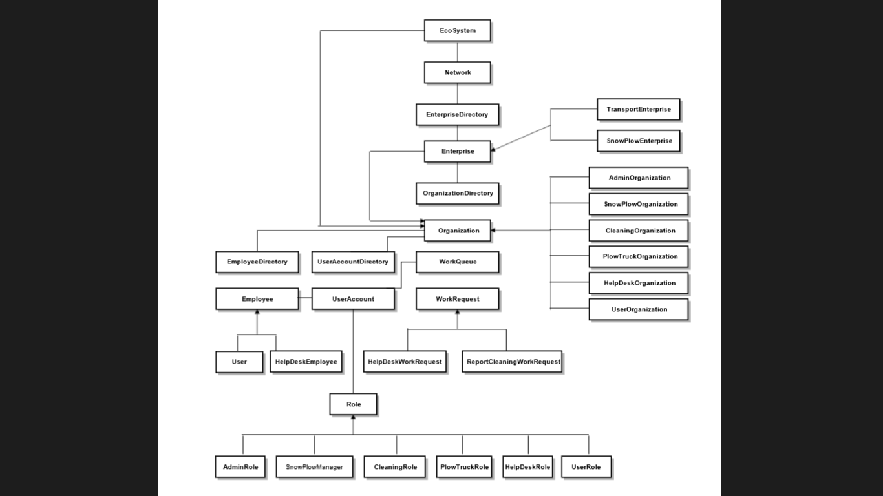
Object Model:

Slide 4
Key Roles:
System Admin Role- Establishes all the networks and enterprises.
Enterprise Admin Role- Adds organizations to his enterprise.
Snow Plow Organization Admin Role- Monitors the sensor measurements of each street and the street area for the snow level and reports the snow cleaning request to the cleaning organization.
Cleaning Organization Admin Role – Checks the snow cleaning request obtained and looks for the available plow truck for the request assignment.

Slide 5
Plow Truck Organization Employee Role- Gets the assigned request and completes the task. If the request is from user then, user is notified whether the task has been finished.
Help Desk Organization Employee Role- Helps users solving their emergency questions.
User Role- Books travel card, Contacts Help Desk, Report Cleaning for snow plowing.

Slide 6
Features:
Enterprise Admin can see the analytics for his organization.
There is communication between Transport and Snow Plow Organization.
When user reports the cleaning request, he will get the notification email when his request gets solved.
User can ask for the online help and can have a conversation with Help Desk Employee and can view his all previous conversations.
When the user buys any travel card, he can print his card as .pdf file. And also he can print ticket anytime he wants.

Slide 7
Thank You!

